Slide 1

Project (5th Semester)
(CS591)
Indian Institute Of Information Technology Kalyani
Mentored By – Mr. Anirban Lakshman

Slide 2
Name Reg No. Roll No.
MEMBERS
Akash Ramanand Rajak 435 19008
Amaan Khan 438 19011
Kumar Saurabh 470 19043
Pallav Dubey 481 19054

Slide 3

Weekly Update
This presentation is to keep track of updates and changes to the project regarding various features added and deployed to the project content.
The presentation will help the group members to handle the work flow with efficiency.

Slide 4
Week 1
The discussion regarding the project began as soon as the topic was assigned.
To make a peculiar real life application of object detection model the group members held proper meets to discuss the steps involved.
Finally after some days the team decided to make use of Image Processing, Video Processing and Object Detection which are rigorous parts of modern Artificial Intelligence.
The project will focus on detection and count of people in live marathon footage.

Slide 5
Week 2
The group members started learning relevant skills and research based learning was taken in account.
After some proper understanding of concepts the team decided to use Harr Cascade Classifier as a xml file consisting of functions and definitions of Image and Video processing.
Since the most popular programming language featuring AI is Python the team started working with it.
Usage of cv2 library helped linking with the xml cascade file easily.

Slide 6
Week 3
An additional library Open CV was used to detect and make program understand functions related to object detection.
Some of these functions are cvtColor(), detectMultiScale(), rectangle() etc.
The program is flexible and can be used with any video extension(.mp4, .mkv, .ovi, etc.) which is taken as input for human detetion.
First test video is used of a open area covering a large number of people.

Slide 7
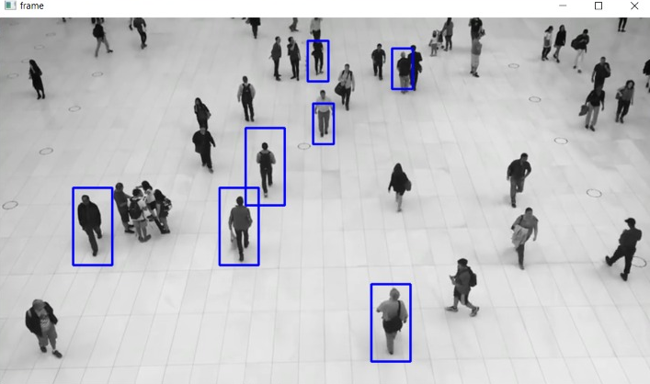
Week 3
The program worked perfectly.

Slide 8
Week 4
Worked on bringing the accuracy to the no. of human body or person body being detected or marked in any real time video of marathon.
Used additional libraries like
  Imutils - a series of convenience functions to make basic image processing functions such as translation, rotation, resizing, skeletonization, and displaying Matplotlib images easier with OpenCV and Python.
  Argparse – this module makes it easy to write user-friendly command-line interfaces.
Also worked on the labelling of the human body detected by the program by the counter which tells us the count of the number of people at that particular instance in the video.

Slide 9
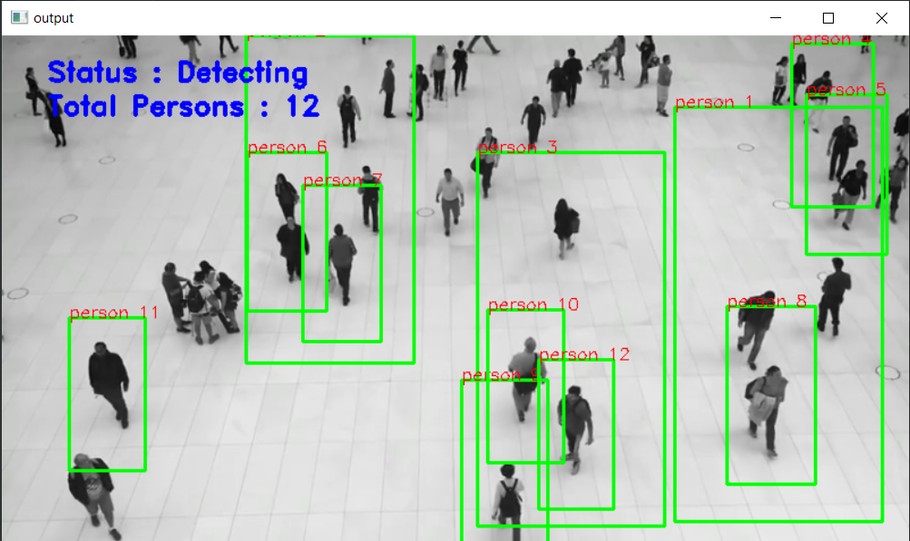
Executed the program and got the output as below with more accuracy on numbers detected and got the labelling also.

Slide 10
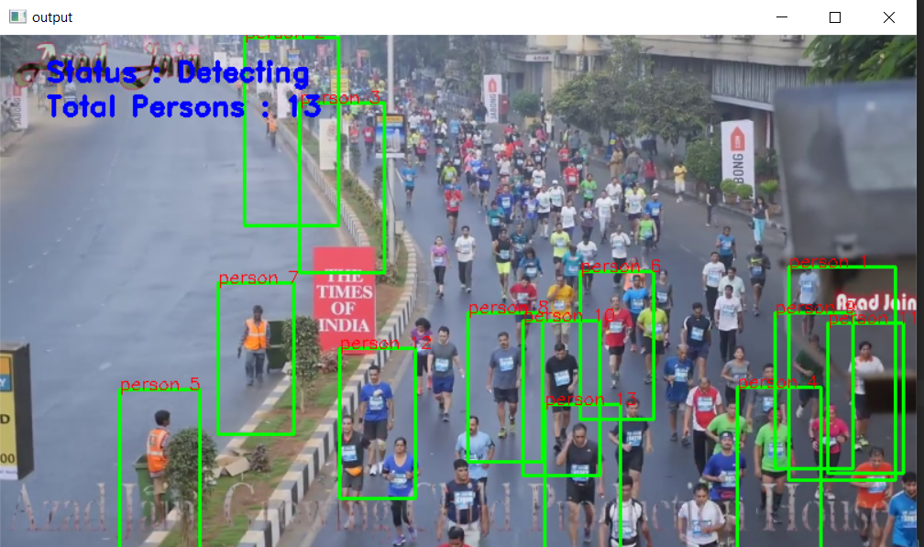

Slide 11
Week 5
We added frontend part in the project. For this we used Tkinter GUI and added different buttons and labels.
Additional Libraries used:
  Tkinter – for frontend GUI window
  PIL – for adding images to the tkinter GUI window
  Messagebox from tkinter – to show any message using dialog box
  Filedialog – to select images and video using select buttons.
When we run the code, a GUI window will open with START and EXIT button on it.

Slide 12
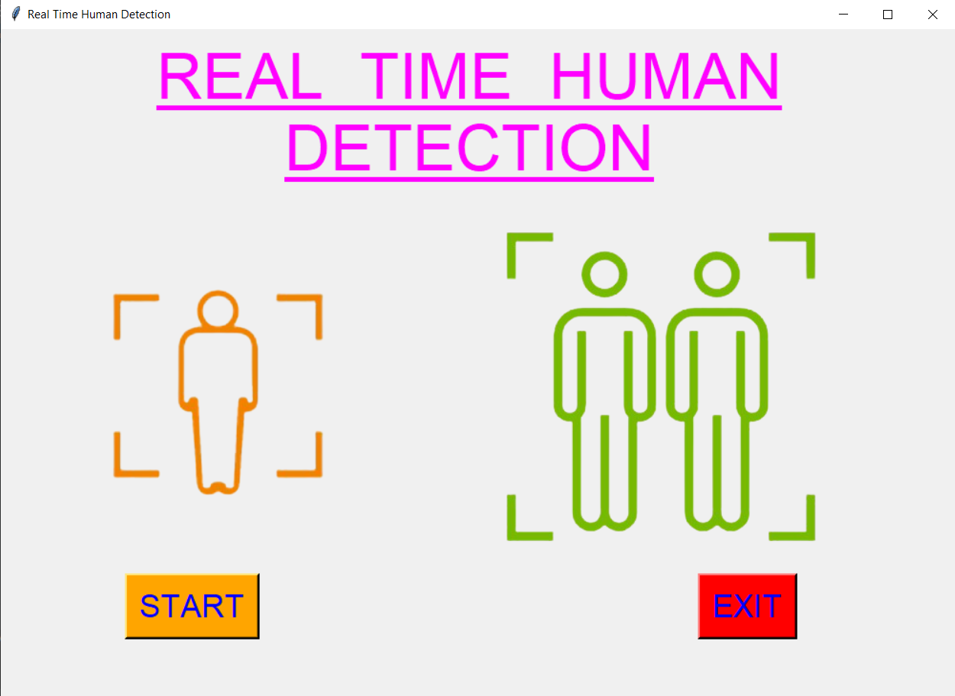

Slide 13
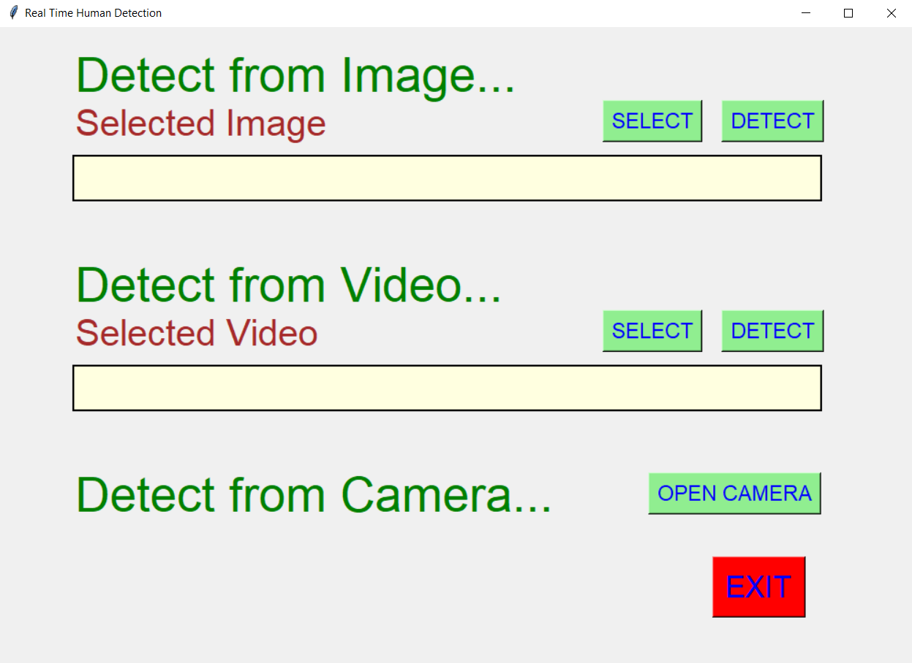
When we click on the start button the application will start and we get different option to detect the human or person from them.

Slide 14
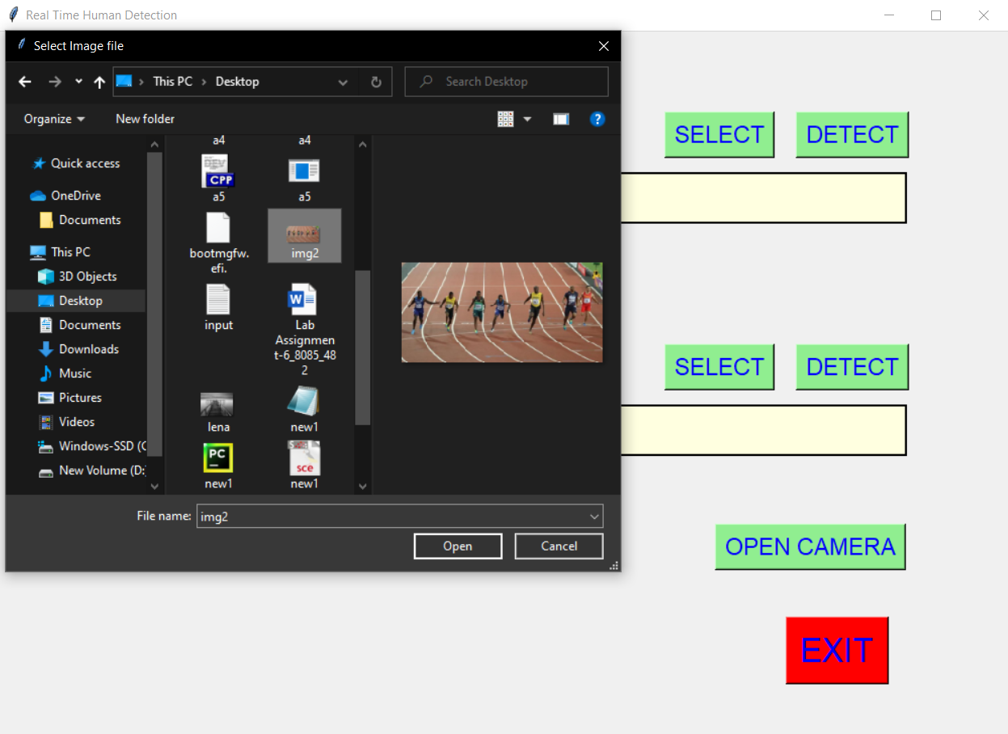
When we click on select button on image option, we get option to select image from the local system and when click on the detect button, an output image is shown which detected human and their count.

Slide 15
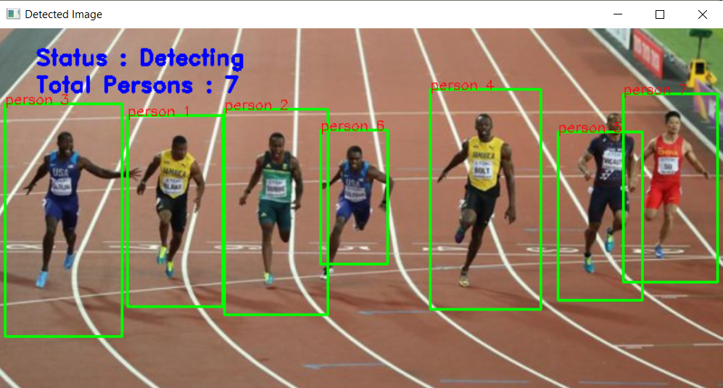
In the same way when we select video from the local system, it will give the output by detecting the humans in the video.

Slide 16
Also we have added option to open the camera and through camera, it can also detect the humans.
Like when we click on the open camera button, the camera will open and it will start detecting the humans and count them which are in front of the camera.

Slide 17
Week 6
We studied on how to increase the accuracy of no. of people count in videos or images.
Using Haar Cascade Classifier
  Here we make use of .xml file for human detection, and using that we detect the humans in real time videos and images.
  At the first we used this method to detect the persons, but the accuracy was not good.
Using Histograms of Oriented Gradients (HOG)
  is a feature descriptor used in computer vision and image processing for the purpose of object detection.
  We used this method currently, but got the same accuracy as Haar Cascade Classifier method.

Slide 18
Along with HOG descriptor we also added the preview button, with which it allows us to see the preview of the image, video selected.
After after detecting, we also printed the max human count in the window.

Slide 19
Using TensorFlow and CNN with Deep Learning
  This is the for various computer vision problems such as Image Cthird method method which we are learning to detect the humans using Deep Learning.
  TensorFlow is an open-source API from Google, which is widely used for solving machine learning tasks that involve Deep Neural Networks.
  CNNs were widely adapted lassification , Object Detection and Object Localization.
  This method gives better accuracy as compared to first two methods, so in the next week we are going to apply this method for detecting and will definitely see some positive result on the accuracy.

Slide 20
Week 7
We implemented the tensorflow method of detecting the human using neural networks.
And we got better accuracy as compared to the 1st method that was Haar Cascade Classifier and the 2nd method that was using HODV descriptor.
Both the earlier method, gave the same accuracy and only few humans are only getting detected and with tensorflow method, accuracy increased very much and almost all the humans got detected.
And along with detecting and counting no. of humans, we also got the accuracy of each human with which it is getting detected.

Slide 21
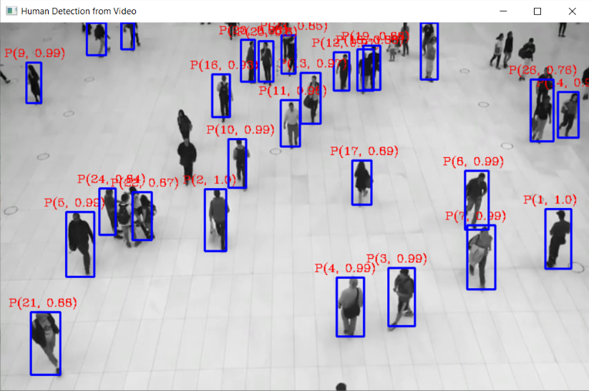
The sample screeshot accuracy increased with tensorflow is as follows:
Here for each detected human, the first term is count and the second term is the accuracy of detection.

Slide 22
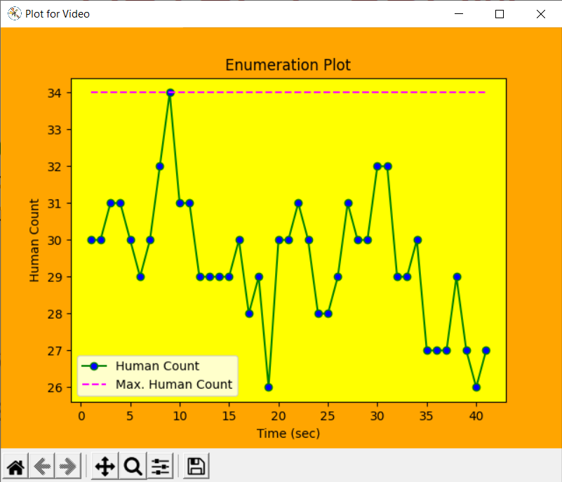
After detection and counting process, we plotted the two following plot using the data collected.
1st is Enumeration Plot :

Slide 23
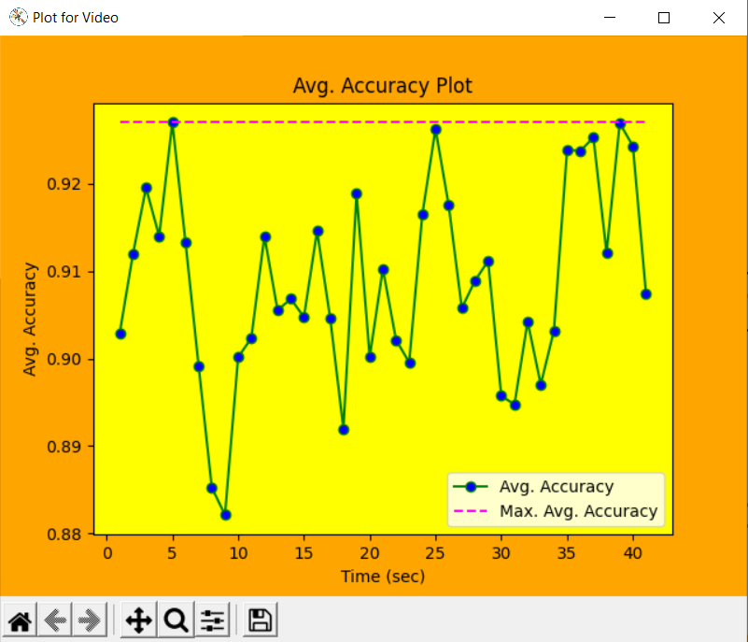
2nd is Avg. Accuracy plot :

